Slide 1
A History of Chemistry

Slide 2
Where did it all begin?
1000 BC – production of Iron from ore
Wine making
Primitive alloys
Farming (Fertilizer)

Slide 3
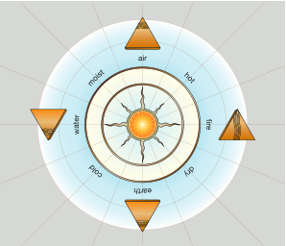
Early Elements
In 340BC Aristotle proposed that all matter was made of composed of earth, wind, fire and water

Slide 4
Alchemy
1500’s – 1700’s
Trial and error, serendipity
Big claims, little returns (gold, universal solvent)
Discovered distillation and recrystallization
14 Basic Elements (didn’t know what elements were) S, Hg, C, Fe, Pb, Cu, Sn, Ag, Au, P, As, Sb, Bi, Zn

Slide 5
How would you go about making/purifying an element?

Slide 6
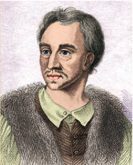
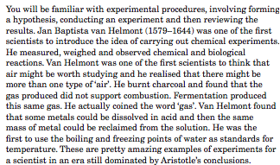
Experimental method Jan Baptista van Helmont

Slide 7
The ‘Fathers’ of modern chemistry

Slide 8
An Element defined
Robert Boyle (English Scientist) in 1661
Defined an element as:
Took until 1900’s to discover most elements.
“Certain primitive and simple or perfectly unmingled bodies, which not being made of any other bodies or of another, are the ingredients of which all those mixed bodies are immediately compounded and into which they are ultimately resolved.”

Slide 9
Joseph Priestley
First person to isolate elemental Oxygen
~ 1780 - 1790
Achieved by using heat to decompose Mercury (II) Oxide → Mercury and Oxygen

Slide 10
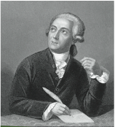
Antoine Lavoisier
1780 – 1790
Observed that Oxygen was the element which was responsible for the increase in mass in combustion reactions…
Developed the Law of Conservation of Mass:
During a chemical reaction, the mass of the products will be equal to the mass of the reactants

Slide 11
So.. What are the differences between Chemistry and Alchemy?

Slide 12
Just Quickly…
Gold was used extensively thousands of years ago by the Egyptians. Which properties of Gold are linked to this early use?
What is the law of conservation of mass?
Apply this law to calculate: The mass of Mercury Oxide which would decompose to produce 2.00g of liquid mercury and 0.16g of oxygen gas.

Slide 13
How do elements get their symbols?
First letter, or two letters of their name
First letters of Latin names (Pb = Plumbum) Copper = Cu (From Cyprus) Latin: cuprum
First letter of element in another language: i.e. Tungsten (W): German - Wolfram i.e. Mercury (Hg): Greek - Hygor Argyros meaning liquid silver

Slide 14
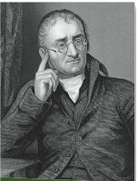
John Dalton
Derived symbols for elements
In 1805 he proposed that matter was composed of atoms, and backed this up with experimental findings

Slide 15
Daltons key ideas
All matter consists of individual atoms
Atoms of a particular element are identical in size, weight and properties
Atoms of each element have a unique weight
Atoms are neither created or destroyed in reactions (WHAT DO YOU THINK ABOUT THIS?)
Compounds are formed from the combinations of the atoms of two or more elements
The proportions and kind of elements is fixed in a given compound
Atoms combine in simple numerical ratios
The most stable compounds of two elements contain the atoms in a one to one ratio.

Slide 16
Daltons key ideas contd..
Gave Hydrogen the relative atomic ‘weight’ of 1 unit, and compared other elements to this HOW WOULD HE DO THIS??

Slide 17
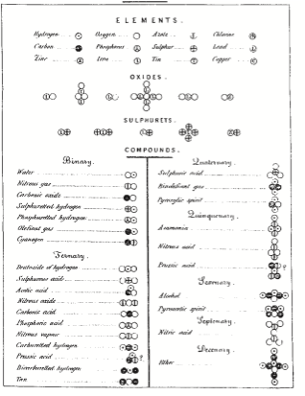

Slide 18
The periodic table
Can you think of some elements with similar properties?
How about different properties?

Slide 19
Jons Berzelius
Gave the elements their various symbols
Synthesized many compounds
Isolated and Purified many of the common elements
Calculated accurate relative atomic masses (published this in 1828)

Slide 20
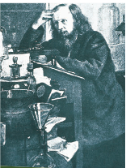
Dmitri Mendeleev
From the vast amount of experimental data available from the previous chemists he determined that: “Chemical properties of the elements vary periodically with increasing atomic mass”
In 1869 devised a periodic table by: - Arranging elements with similar properties into columns (groups) - Arranging elements in order of increasing relative atomic mass into rows (periods)

Slide 21
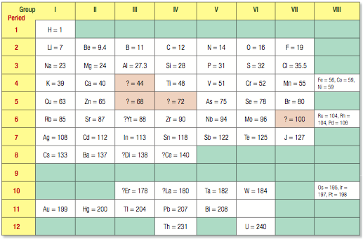

Slide 22
The Periodic Table
Mendeleev’s table wasn’t complete but..
It allowed him to predict properties of undiscovered elements including colour, density and boiling point/melting point
Other contributors to the Periodic Table: John Newlands, Lothar Meyer

